Slide 1
IN THE NAME OF
ALLAH
WHO IS KIND
AND
MERCIFUL

Slide 2
PSST
TECHNICAL WORKSHOP BHOORBAN
2012

Slide 3
INVERSION
LOSSES
IN
EVAPORATORS

Slide 4
AUTHOR
ENGR. MUHAMMAD AJMAL SIDDIQUI
M.B.A (Finance),
B.Sc. CHEMICAL ENGINEERING CHIEF CHEMIST

Slide 5
RAMZAN
SUGAR MILLS
LIMITED
CHINIOT.

Slide 6
ACKNOWLEDGEMENTS

Slide 7
I am very thankful to
ALMIGHTY ALLAH,
Who gave me the knowledge
and courage to convey it to
all of you efficiently and
excellently.

Slide 8
I would like to show my greatest appreciation to
Mr. Javed Iqbal, Project Director,
Ramzan Sugar Mills Limited,
for his guidance and
encouragement.

Slide 9
I would like to gratefully
acknowledge the enthusiastic
supervision of
Mr. Waseem Ghafoor,
General Manager Production,
during this work.

Slide 10
I am grateful to
Mr. Abdul Latif,
GM(E), Mr. Malik Abdul Sattar, GM(Cane), Mr. Ghulam Jafar,
DGM(T) and , Mr. Zahid Ali, DGM(F) for their
precious suggestions.

Slide 11
I thank Mr. Muhammad Yasin,
Production Manager, Mr. Javed Virk, Manager Administration, Mr.
Rafaqat Ali Javed, Manager
Lab. and Mr. Sher Afzal Niazi,
Chief Engineer for the
technical and relevant
discussions on the topic.

Slide 12
I would also like to thank
Mr. Abdul Jabbar, Deputy
Chief Chemist, Mr. Zeeshan
Ali, Senior Chemist and Mr.
Kashif Imran, Shift Chemist,
for all their valuable
assistance in successful
completion of this work.

Slide 13
INVERSION LOSSES
IN
EVAPORATORS

Slide 14
INTRODUCTION:

Slide 15
The mixture of equal amounts
of glucose (dextrose) and
fructose (levulose) is called
"invert" sugar and when the
quantities of glucose and
fructose are not equal in the
mixture, it is known as
’reducing’ sugar.

Slide 16
They occur naturally in
sugar cane juice at
3 to 5% of total soluble
solids and in beet juice
at 0.4% to 0.8%.

Slide 17
The content of glucose and
fructose in sugar cane juice
varies greatly depending on the
varieties and the maturity
of cane, weather,
geographic conditions
and the condition of fertilization.

Slide 18
In evaporators, sucrose may
be lost either chemically
through acid catalyzed
inversion or physically by
Vapour entrainment.

Slide 19
The main reasons for sucrose
inversion are high temperature,
long retention time and high
acidic media, especially if there
is a dead volume in the
evaporators, which favours
the formation of organic
acids from invert sugars.

Slide 20
The acids become
concentrated across the
evaporators and the
resulting
drop in pH causes sucrose
inversion.

Slide 21
WHAT IS SUGAR
INVERSION?

Slide 22
Sucrose is a Disaccharide of
combined glucose and
fructose, having chemical
formula C12 H22 O11.
The hydrolysis of sucrose
is presented in the following
chemical reaction.

Slide 24
The following figure describes
the mechanism of this hydrolysis
reaction. The structure of the
Disaccharide sucrose molecule shows the
monosaccharide units of
glucose and fructose combined
by the central oxygen atom,
glucose on the left and fructose
on the right.

Slide 25
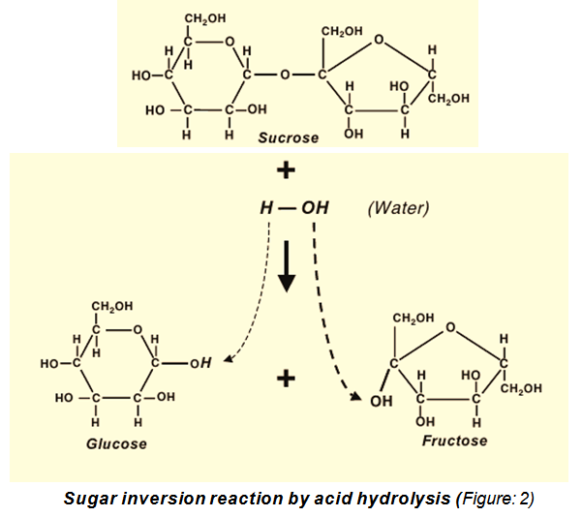

Slide 26
Sucrose inversion occurs by
splitting this disaccharide
into its components glucose
and fructose. Inverted sugar
has a high affinity with water
and is the cause of making
products retains moisture.

Slide 27
Sucrose inversion is strongly dependent on pH, temperature and solid content.

Slide 28
Increasing solid content
(lime juice),
pH, and temperature during
both heating and storage at
room temperature, increases
the rate
of sucrose inversion.

Slide 29
THE FALLING FILM
EVAPORATOR (FFE):
This popular evaporator is
being considered by many
sugar industries.

Slide 30
In this type, the juice travels
from top to the bottom and
as it descends, it takes the
entrained vapour along with
it to a lower chamber, where
the vapour and liquid are
separated.

Slide 31
The falling film evaporators
have many advantages over
the conventional evaporators
as below;

Slide 32
The FFE's have better heat
transfer, as there is no
elevation in boiling point due
to hydrostatic pressure.
Due to short contact time of juice and steam, high pressure and temperature steam can be
used.

Slide 33
Using vapour of all the
effects, steam consumption
can be reduced to maximum
level.

Slide 34
The design of
the evaporators
is such that, the juice is in
contact with the heating
surface in a thin layer over
the length of the heating
surface.

Slide 35
So the vapour is entrained
with the juice filling the
interior of the tube. This
avoids the vapour bubble
obstruction, which is
present in the conventional
evaporator.

Slide 36
In Ramzan Sugar Mills Limited,
Chiniot, we got the opportunity
to install a pair of falling film
evaporators (3000 M² + 3000 M²)
and by the grace of
ALMIGHTY ALLAH,
had a successful trial of about
20 days at the end of crushing
season 2010-2011.

Slide 37
At that short time,
a deep study about all
of the features of
falling film evaporator
could not be conducted.

Slide 38
In the season 2011-2012 the
falling film evaporator made
allowance for improving
evaporation scheme to a Quint
Set up, giving rise to an export
of 3-4 Megawatt electricity
per hour.

Slide 39
But, sometimes, we have to blow steam. To condense excessive steam, now a 6 MW condensing/extraction turbine has been installed.

Slide 40
The falling film evaporator
has immense potential for
achieving substantial
savings in steam.

Slide 41
It is believed with such a system,
it is possible to reduce the steam
consumption in evaporators to
less than 36%. In this phase,
in fact, the falling film evaporator
provided a good chance to us
for 6% to 7% of steam saving
and hence redeeming of a
considerable amount of bagasse.

Slide 42
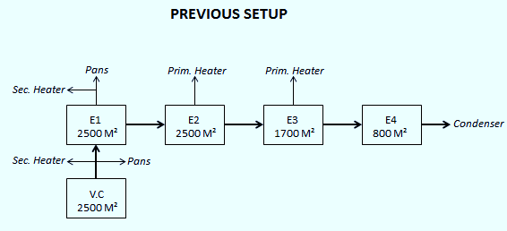
Steam Consumption 54% (Figure: 3)

Slide 43
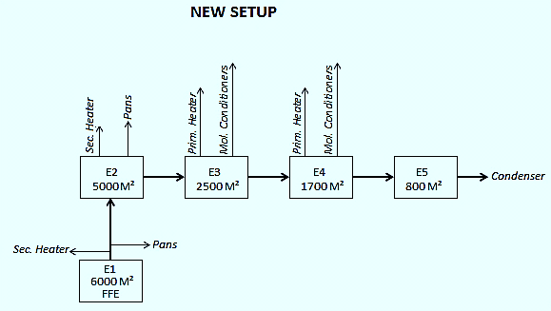
Steam Consumption 47% (Figure: 4)

Slide 44
At our falling film evaporators
having 10 M long tubes, an
evenly distributed juice film,
subjected to gravitational pull,
has calculated velocity of about
14 M/sec, which means a very
low juice/steam contact time.

Slide 45
Therefore, with controlled
temperature and pressure of
exhaust steam and minutely
checked pH of the clear juice,
we are efficiently able to
minimize inversion losses as
compared to the Robert Type
evaporators.

Slide 46
It was observed that after
remaining about 250 hrs. in
operation, the rate of
evaporation of falling film
evaporators diminishes
considerably.

Slide 47
So, tube cleaning schedule is
followed by us after every
10 days. For cleaning, separately
prepared 2.5% Caustic soda
solution is circulated through
the FFE tubes for 2.5 hrs,
maintaining 90°C temperature.

Slide 48
Then the tubes are washed
thoroughly. Afterwards, 3.5%
Formic acid solution is
circulated for 3 hrs. at
90°C, which optimizes the
cleaning of the tubes.

Slide 49
SUGAR INVERSION IN
FALLING FILM
EVAPORATOR:
An Indian Sugar Technologist,
Shankaranath reveals the
extracts of his study in the
following way;

Slide 50
'The average contact time
between juice and steam in a
falling film evaporator is about
30 seconds as against 3 minutes
in the Kestner evaporator and
6-8 minutes in the conventional
short tube evaporator.

Slide 51
This offers an excellent
potential for using high
temperature and pressure
steam, as the risk of
caramelization
is avoided / reduced
on account
of low contact time.

Slide 52
Hence, 1.5 kg/cm² steam at
temperatures of 120 °C can be
used in the 1st effect of the
evaporator. But for a safe
side and surety against inversion
of sugar, in Ramzan Sugar Mills,
Chiniot, Exhaust Steam pressure
is always kept in the range
of 1 kg/cm² to 1.2 Kg/cm².

Slide 53
SUGAR INVERSION
IN ROBERT TYPE
EVAPORATOR:

Slide 54
A combined study established by
Gillian Eggleston, Michael
Damms, Adrian Monge and
Trevor Endues shows that
Seasonal effects of sucrose
losses across evaporators were
also dramatic with sucrose
losses being lower in mid-
season, when the best
sugarcane quality occurs.

Slide 55
The higher losses in the early
season can be attributed
mostly to the low quality of
cane, as the evaporators are
comprehensively cleaned
in the off-season before
crushing begins.

Slide 56
Greater amounts of impurities, including
glucose, fructose, acids, and salts
further catalyze inversion of sucrose.
Higher target pH values in the early
season or when immature cane is
being processed, may offset these
extra losses, although the target
pH would have to be a compromise
as increased lime addition will
counteractively increase some scaling.

Slide 57
Some of the highest sucrose
losses also occur in the
late season.

Slide 58
Although cane quality often decreases
again in the late season (but not to
the extent of the early season),
these increased losses are most
likely because of the build-up
of scale resistant to cleaning
in the later evaporators
after the pre-evaporators, which
becomes worse as the season
endures.

Slide 59
A higher target pH in late
season is not advocated
as resilient scale in the
later evaporators would
over ride pH effects anyway.

Slide 60
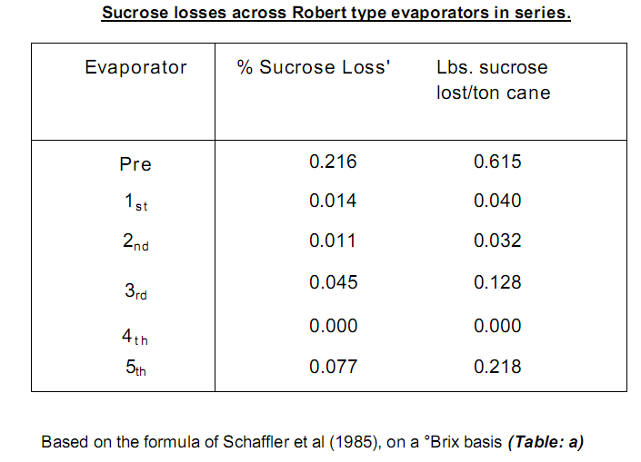

Slide 61
At high temperature and high
acidity, inversion increases.
Inversion losses of evaporators
are measured by 'Glucose Ratio
to Juice' i-e Ratio of reducing
sugar to sucrose (Pol) in Juice.

Slide 62
Ratio decreases slightly
between Clarified Juice and
Syrup with a value of
about 4% (Honig). If it increases
or stationary, means inversion
in evaporators.

Slide 63
This is due to;
High temperature in first vessel.
(ii) Maximum retention time in vessel due
to short circuit from entry to exit.
(iii) Too low pH.

Slide 64
Normal pH drop between Clear
Juice and Syrup is 0.30 and not
exceeds to 0.50 (Honig). Normal
inversion losses in course of
evaporation should not exceed
0.2% of sucrose as maximum.

Slide 65
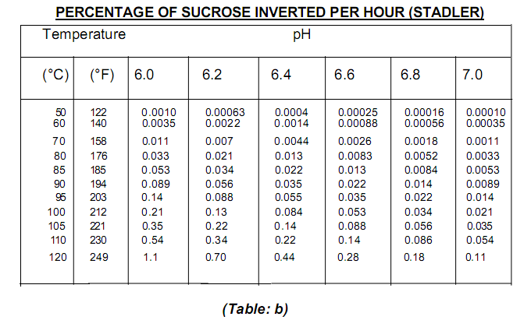

Slide 66
For a standard quadruple
effect, with the first vessel
heated by steam at 112°C
(234°F). Claassen evaluates
losses of sucrose by
inversion at:

Slide 67
1st vessel: 0.020% of sucrose in juice
2nd vessel: 0.015% of sucrose in juice
3rd vessel: 0.010% of sucrose in juice
4th vessel: 0.005% of sucrose in juice
0.050% of sucrose in juice
Or, approximately it is 0.007 % on cane.

Slide 68
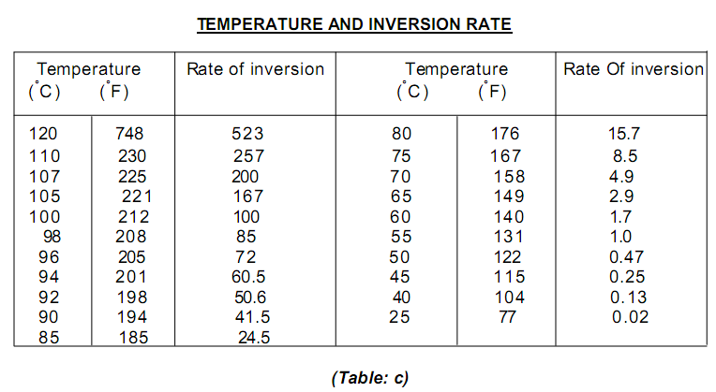

Slide 69
GENERAL DISCUSSION
AND CONCLUSIONS:

Slide 70
The need for efficient
utilization of energy dictates
that large amounts of vapour
should be bled from the first
two effects of evaporators.

Slide 71
To achieve this large portion
of the total evaporation has
to be done in the first two
effects and at temperatures
above 100°C.

Slide 72
If too much evaporation is
done in first two effects
then there is a danger of
combining conditions of low
pH and high temperature.

Slide 73
Therefore, extensive vapour
bleeding contributes to
sucrose degradation.

Slide 74
The low pH is caused by
a combination of factors.
Firstly, as evaporation progresses
the existing acids become more
concentrated and therefore there
is a relationship between brix
and pH. Secondly, the pH
decreases with increasing
temperature and thus a combination of high brix and high
temperature causes conditions
of low pH.

Slide 75
If decomposition of invert
sugar occurs then the acid
end-products further
decrease the pH and
thereby catalyze additional
inversion.

Slide 76
Most losses occur in the
third/fourth evaporators
where there is an
appreciable scaling and
blocking of evaporator
tubes resulting in longer
retention time.

Slide 77
THANK YOU

