Slide 1
Biological Control Laboratory Management
Amjad Sultan
Pangrio Sugar Mills Limited

Slide 2
Introduction
Biological control is an important part of IPM which is being adopted in the recent era of pest control.
Sugar mills are establishing biological control laboratories for the methods of control for enhancing yield and recovery of sugarcane crop
Most of the sugar mills have recognized the importance of biological control laboratories by extending and establishing biological control laboratories.

Slide 3
Problems
not being made up to standard
Mismanagement and Sanitary measures are not adopted in the laboratory.

Slide 4
Downfall of Laboratories
Sugar mills management hired non technical experience person and established laboratories not up to standard.
culture is being destroyed by mites and they do not have a support to revive in the same season
If sugar mills want to revive again they need two months out of 7 month of season they have
Resulting closing of the laboratory or they have to wait for the next year

Slide 5
Consultancy
consultant hired by the mills does not provide sufficient knowledge
how to manage all the stuff as they do not have provided the basic knowledge to the person they train and they become important in this regards
consultant does not have proper mites’ free culture that they have provided to their clients
Consultant gets more and more approach to the new clients without providing the basic need for their existing clients

Slide 6
Sugar mills management are more often misguided by the consultant regarding the infra structure, lab equipment, card formation and worker strength
They experience person in this field not want to share their experience as a danger by not to be replaced by literate persons

Slide 7
Laboratory Structure
Laboratory room should not be interconnected.
Running culture and process culture rooms should be apart
There should be four rooms for in a lab
  Running culture
  Process culture
  Trichogramma rearing / card formation
  Chrysoperla rearing
Washing and egg sieving area should be made out side the laboratory

Slide 8
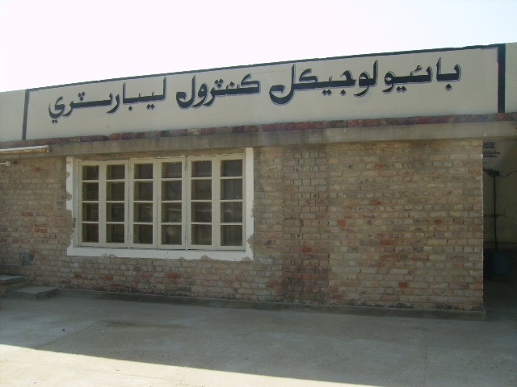
Biological control Laboratory

Slide 9
Sanitation around Lab
Maximum culture should be made for the quick revival in case of culture destruction from mites
There should be no plantation near the laboratories which act as a host for mites
Person from the field should not be allowed

Slide 10
Jar System
Jars system was the most economical and safest system
Moth collection should be done in jars
Jars system confine the movement of mites and can be discarded away easily after deep freezing the jars
Use of vacuum pump or wet cloth
Daily use Deep freeze cloth in both system
Wet cloth provide safe collection of moths.

Slide 11
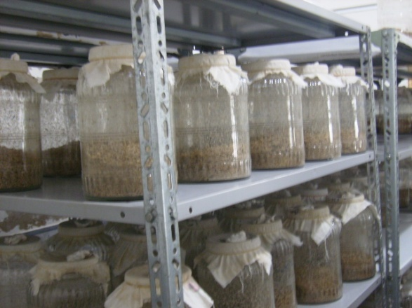
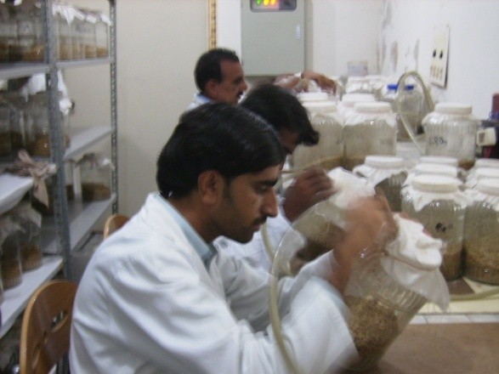
Jar system & Moth Collection

Slide 12
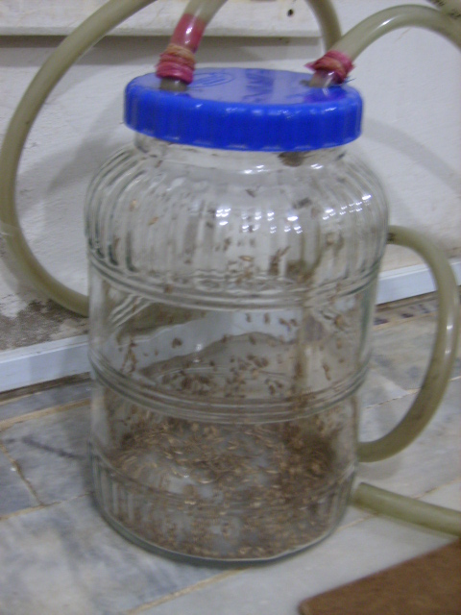
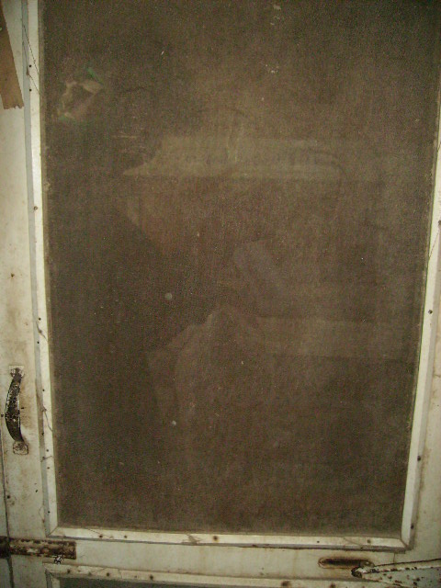
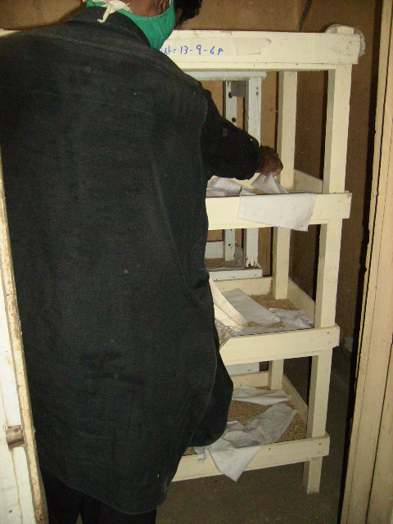
Moth Collection

Slide 13
Making of Culture
Good quality can important role in lab
Wheat with broad grains should be used
Wheat should also be infested free and kept in freezer
Hot treatment will provide insect and soil free soft grain

Slide 14
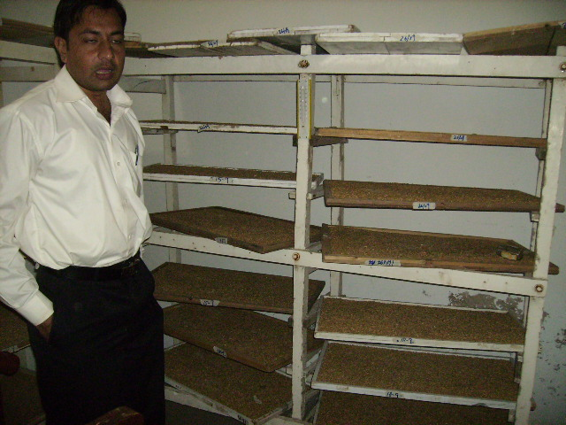
Making of culture

Slide 15
Man Power
Moth Collection
  3 persons
  Card Preparation
  2 persons
Chrysoperla
  2 persons
Culture/Washing/Egg Collection
  1 person

Slide 16
Egg collection
70 mesh sieve
Old or new arrowroot flour should be deep freeze
Egg collection should be done in evening or early in the morning

Slide 17
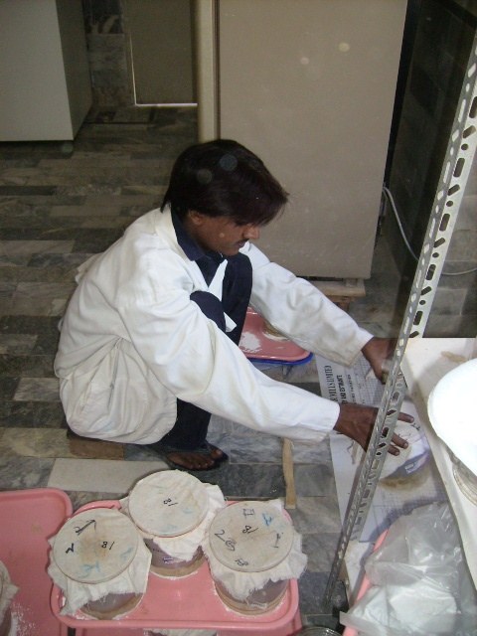
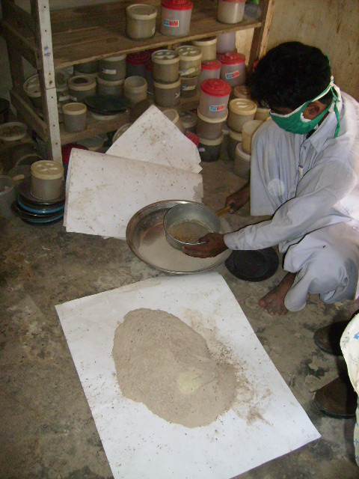
Collection of eggs

Slide 18
Man Power
Lab Officer
  One
Senior Lab Technicians
  One
Lab Technicians
  Three
Locals should be appointed

Slide 19
Humidity and temperature
Temperature should be maintain on 26 .C
Humidity above 80%
Air should be circulated by fan.
At night, water should be spread on floor

Slide 20
Demand of Laboratories
Laboratories should be at division and district level by the government

Slide 21
Acknowledgement
MD (Mr Aftab Ahmed)
GM (Mr Hasan Iqbal)
DGM (Mr. Syed Iqbal Ahmed Rizvi)
HOD (Mr. Ghulam Sarwar Chandio)
CM (Mr. Saqlain Abbas Mirza)

